Slide 1
Thermal Analysis
DSC, TGA, TMA, DMA, Rhemoter

Slide 2
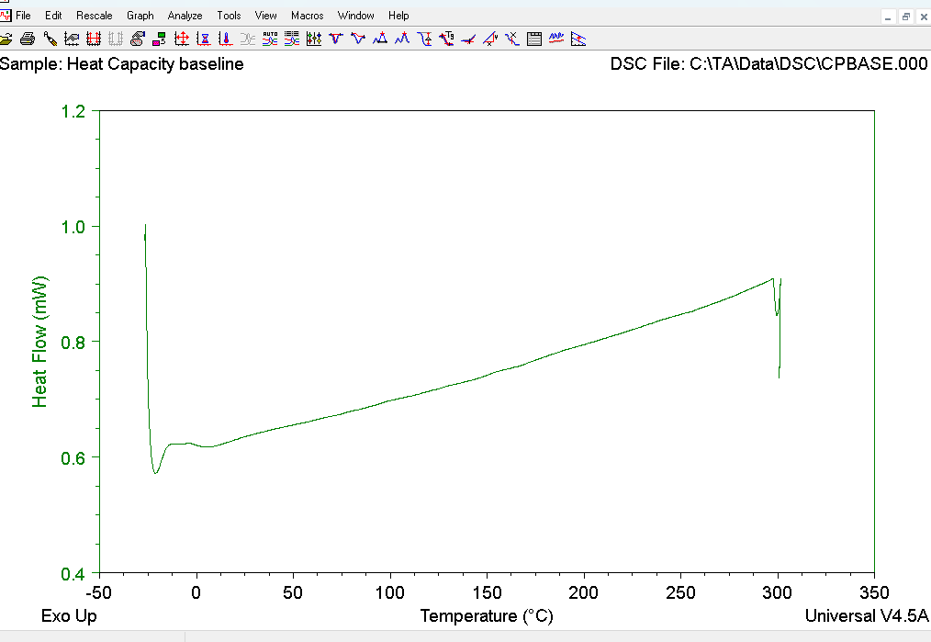
DSC Baseline

Slide 3
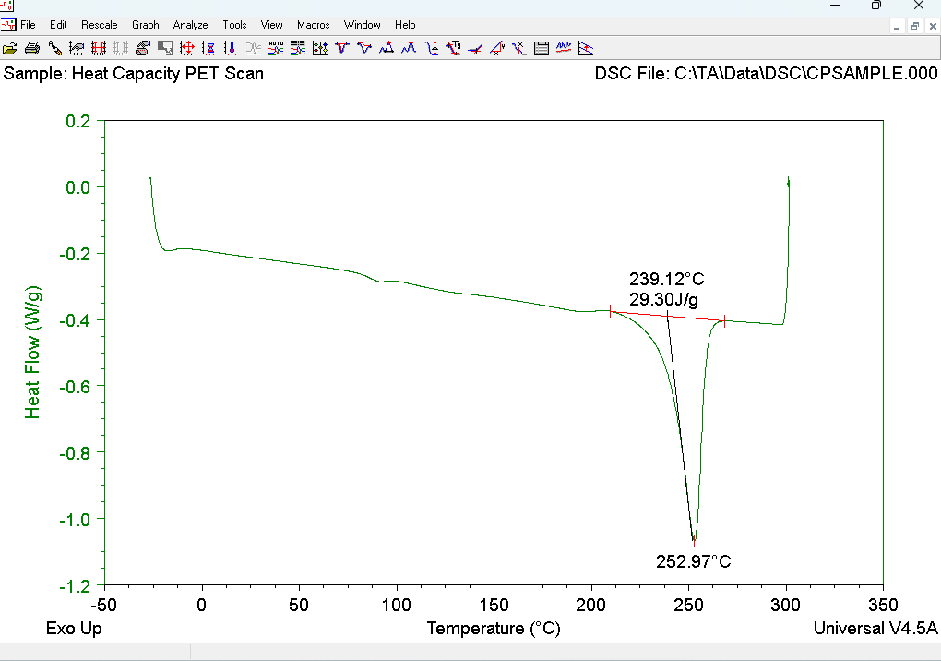
DSC Specific heat Tested

Slide 4
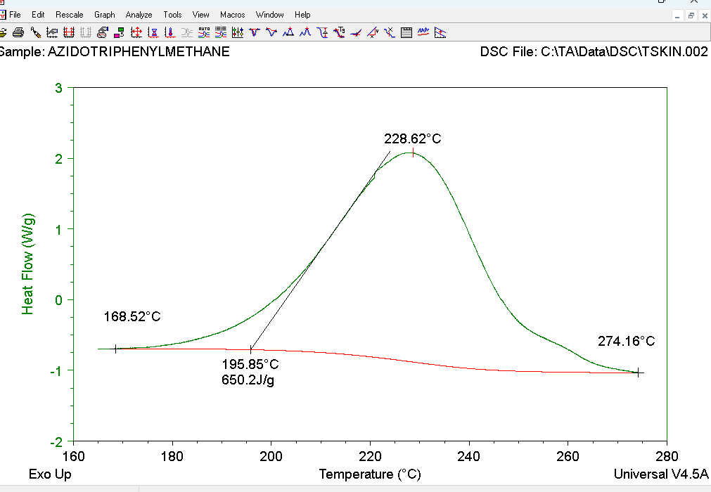
DSC Exothermic Reaction

Slide 5
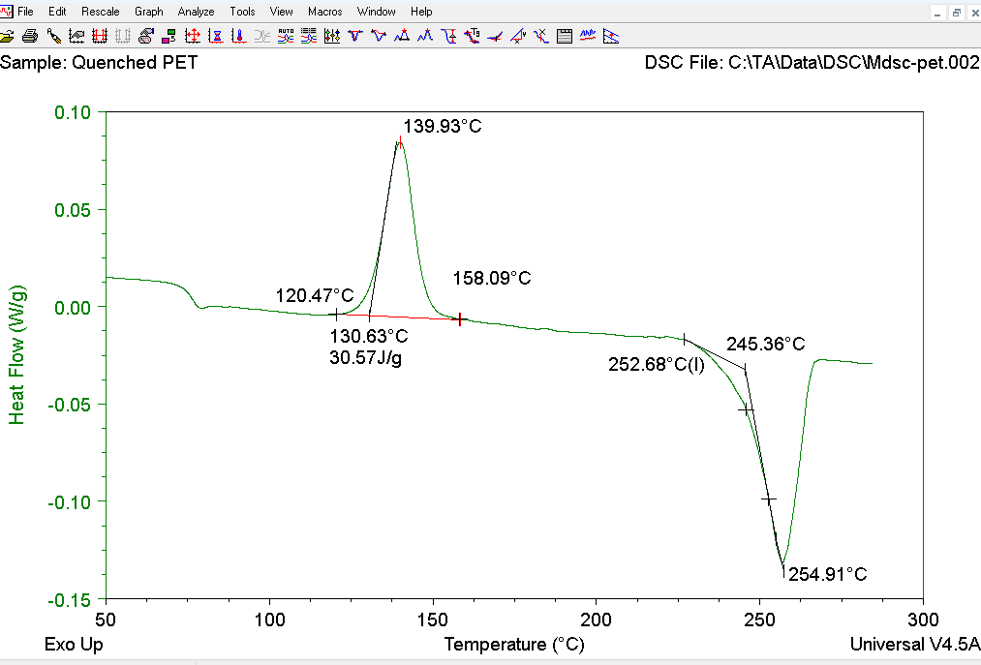
Exothermic and Tg (Glass Transition)

Slide 6
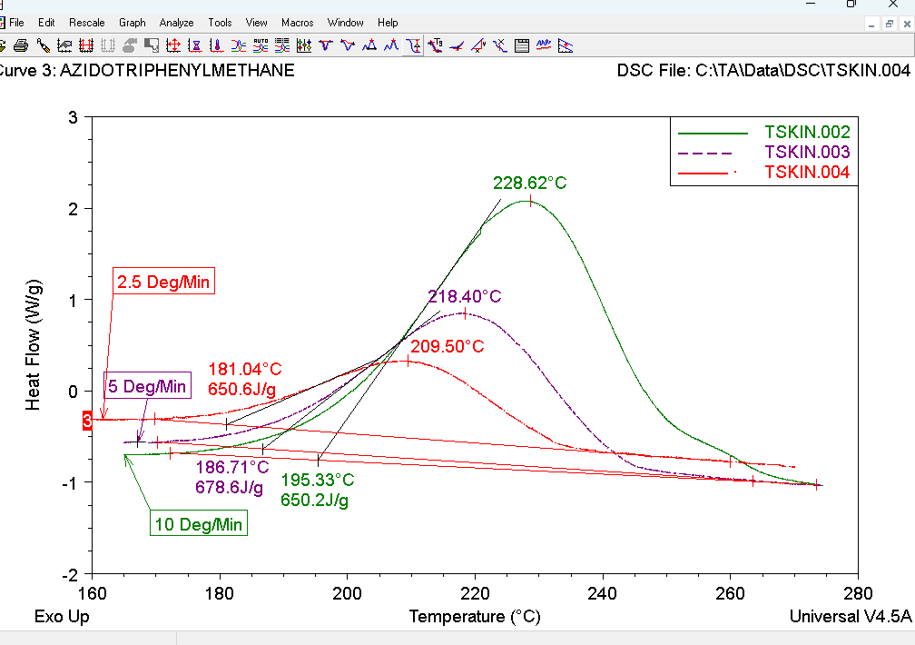
Same material Different Heating Rate

Slide 7
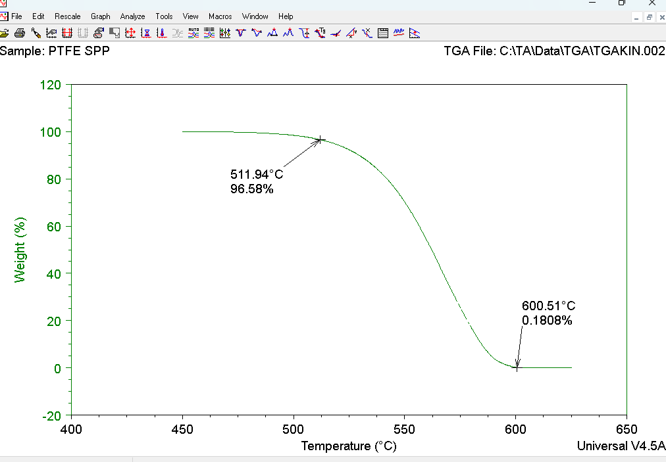
TGA Heat vs weight in percentage

Slide 8
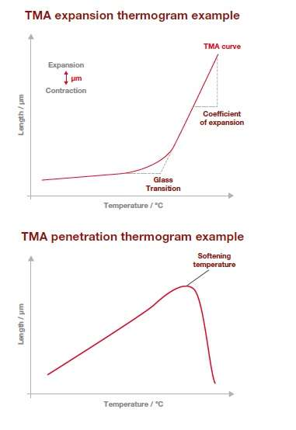

Slide 9
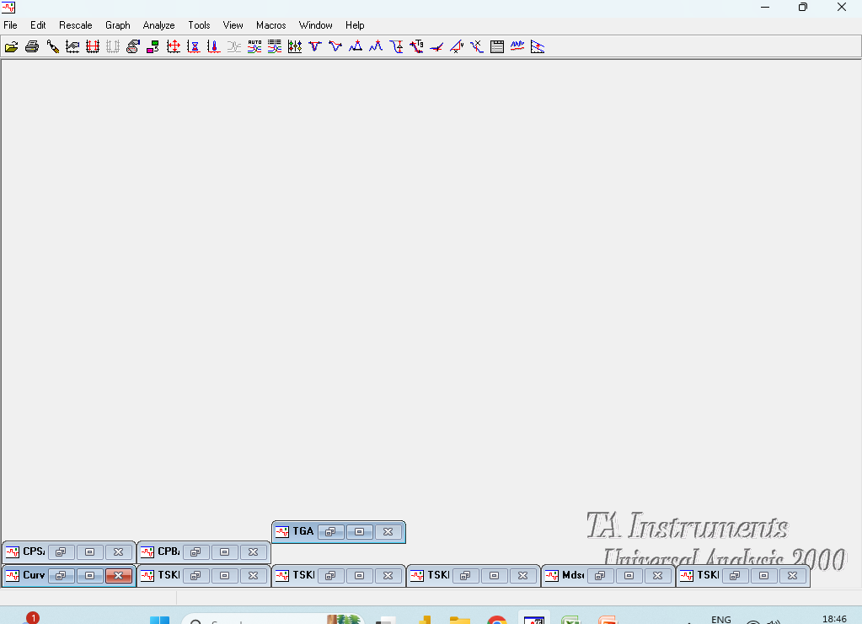
TA Universal Analysis tool

Slide 10
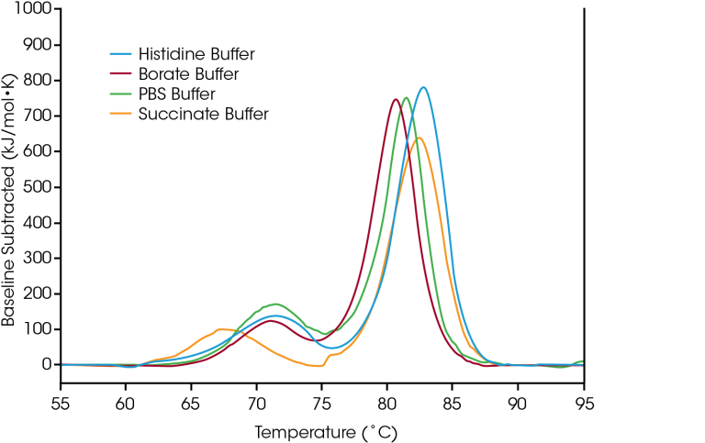
Baseline

Slide 11
TGA

Slide 12
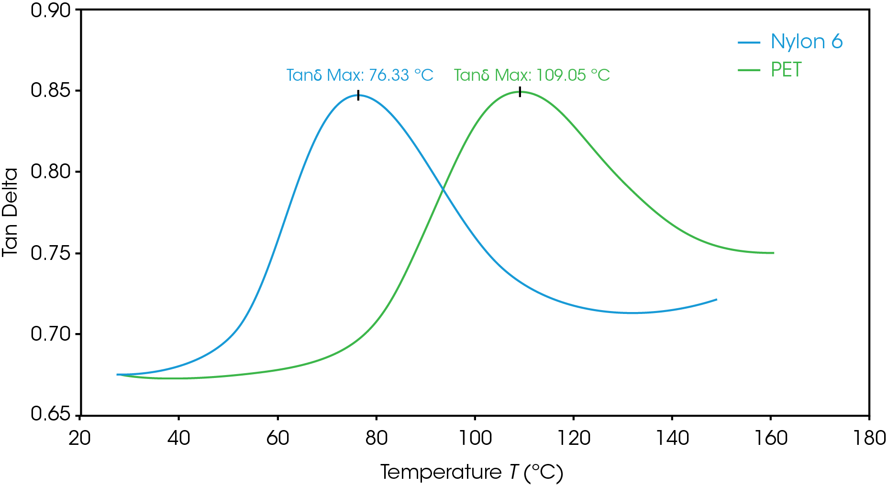
CTE By TGA

Slide 13
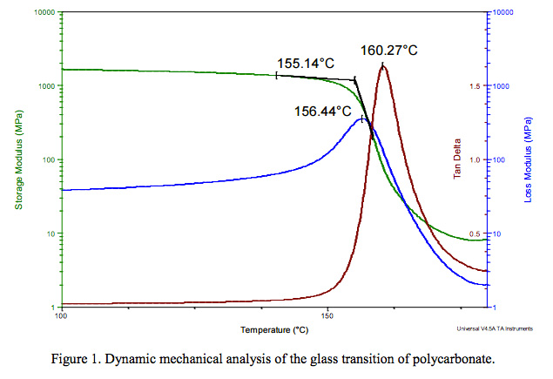
DMA Curve

Slide 14
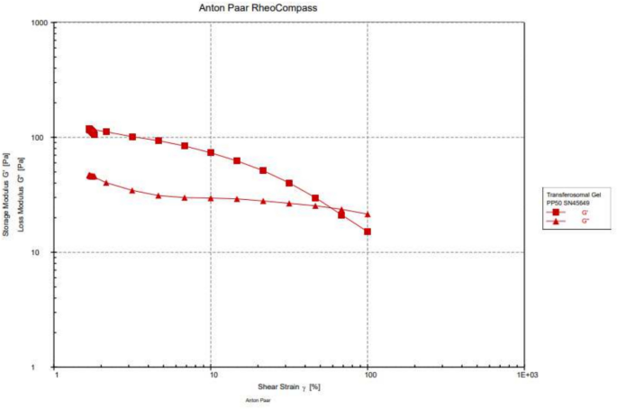

Rheometer Graph by Antonpaar

